Slide 1

WELCOME
Summary
FINAL PRESENTATION OF PROJECT
Power BI
follow
SQL
Tableau
Excel
Questions
KPI List
Group
Takeaway
OLIST STORE E-COMMERCE

Slide 2





S SREEDHAR
GOWD
CHINTTIBOINA NAGA VENKATA NANDA KISHORE
Mrs PRAJAKTA ROHIT ZIRKANDE
Summary
Power BI
Excel
Tableau
KPI List
Group
SQL
Takeaway
Questions
SMRUTISHREE BEHERA
DIKSHA
GUPTA
PRAKRUTI PANDYA
ASRA FATEMA
.ZUBAIR.QUAZI

Slide 3
PROJECT SUMMARY
To analyze Olist Store e-commerce data using Excel, SQL, Tableau, and Power BI to identify sales and customer behavior trends, evaluate delivery and seller performance, and support data-driven decision-making to improve operational efficiency and customer satisfaction.
KEY OBJECTIVES
Build a SQL data model linking orders and revenue
Integrate customer, seller, product, and delivery data
Create interactive dashboards for business insights
Clean and prepare data for accurate analysis
Automate reports to support faster decision-making
Power BI
Tableau
Excel
KPI List
Group
SQL
Summary
Takeaway
Questions
IMPACTS
Here are impact points for Olist store Ecommerce:
Higher operational efficiency
Reduced data inconsistencies and errors
Improved customer shopping experience
Time-saving automated reporting
Clear visualization of key sales and delivery metrics
Better coordination between sellers, logistics, and operations
Increased customer engagement and satisfaction
Stronger data-driven business planning

Slide 4
KEY PERFORMANCE INDICATORS
Weekday vs Weekend Payment Statistics:
Analyzes order volume, total payment value, average payment amount, and payment method usage across weekdays and weekends to understand changes in customer purchasing behavior.
High-Rated Credit Card Orders (Review Score = 5):
Measures the number of orders with a 5-star review that were paid using a credit card, helping assess customer satisfaction and preferred payment methods.
Average Delivery Time:
Calculates the average number of days taken to deliver pet shop products, helping evaluate delivery efficiency and identify category-specific logistics challenges.
Average Order Price & Payment Value:
Analyzes the average product price and payment amount for customers from São Paulo to understand regional spending behavior and support targeted business strategies.
Shipping Days vs Review Score Relationship:
Examines the impact of delivery time on customer satisfaction by analyzing the relationship between shipping duration and review ratings.
Summary
SQL
KPI List
Power BI
Tableau
Takeaway
Excel
Group
Questions

Slide 5
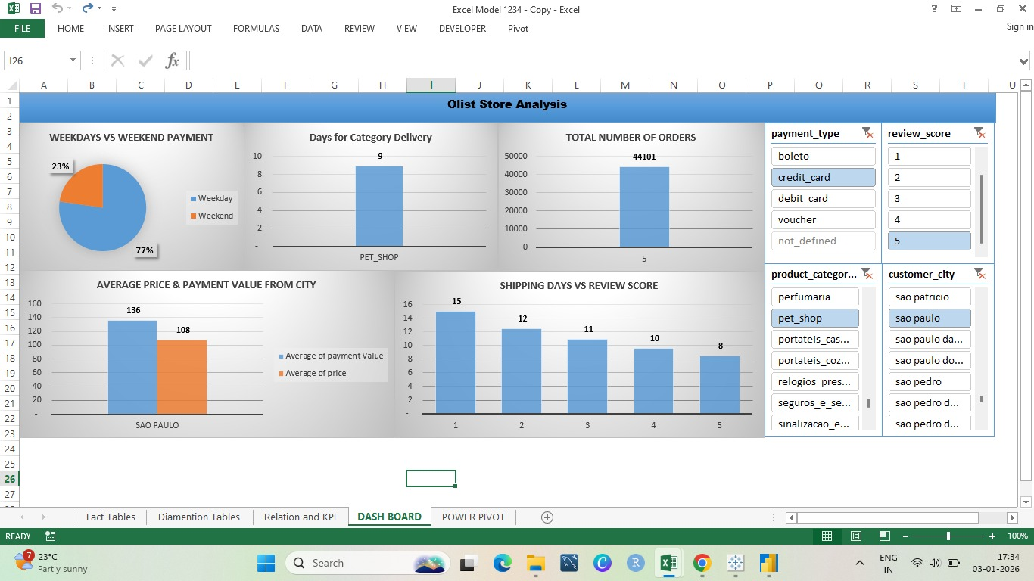
EXCEL DASHBOARD
Power BI
Excel
Summary
SQL
Tableau
KPI List
Group
Takeaway
Questions
INTIAL FINDINGS & DATA TRENDS
Handled over 100,000 orders, showing strong sales activity and consistent customer engagement.
Top regions: São Paulo and Rio de Janeiro lead in order volume, highlighting key markets.
Best-selling categories: Electronics, fashion, and home appliances drive most sales.
Customer behavior: Majority are one-time buyers, with repeat purchases steadily growing.
Revenue & satisfaction: High revenue from top categories; most products have good ratings, though some show delivery or quality complaints.

Slide 6
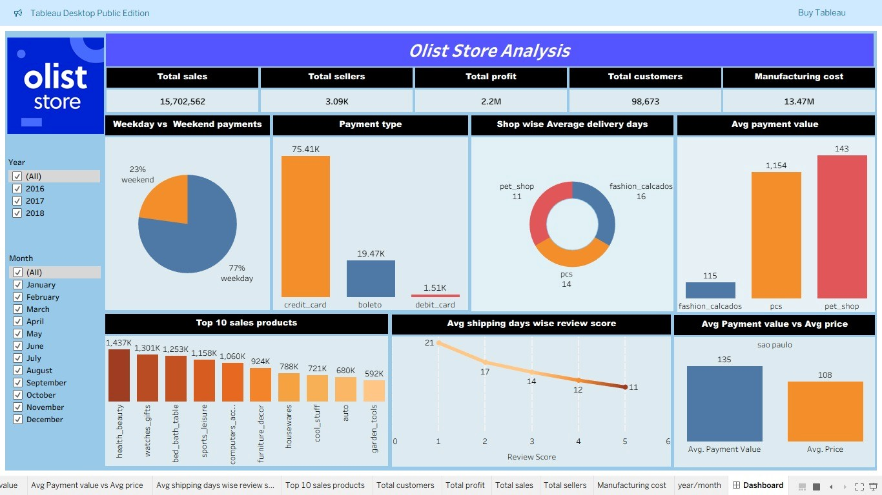
TABLEAU DASHBOARD
Power BI
Summary
SQL
Tableau
Excel
Takeaway
KPI List
Group
Questions
VISUALIZATIONS AND INSIGHTED
Revenue & Sales: Total sales 15.7M and profit 2.2M, driven by top categories like health & beauty, watches, and home appliances.
Customers & Sellers: 98,673 customers and 3,090 sellers, showing a strong, active marketplace.
Delivery Performance: Average delivery days vary by shop (11–16 days), highlighting logistics improvement opportunities.
Payment Insights: Credit cards dominate transactions; avg payment values vary by shop, indicating spending trends.
Regional Demand: São Paulo shows high average payment vs. price, reflecting strong market demand.

Slide 7
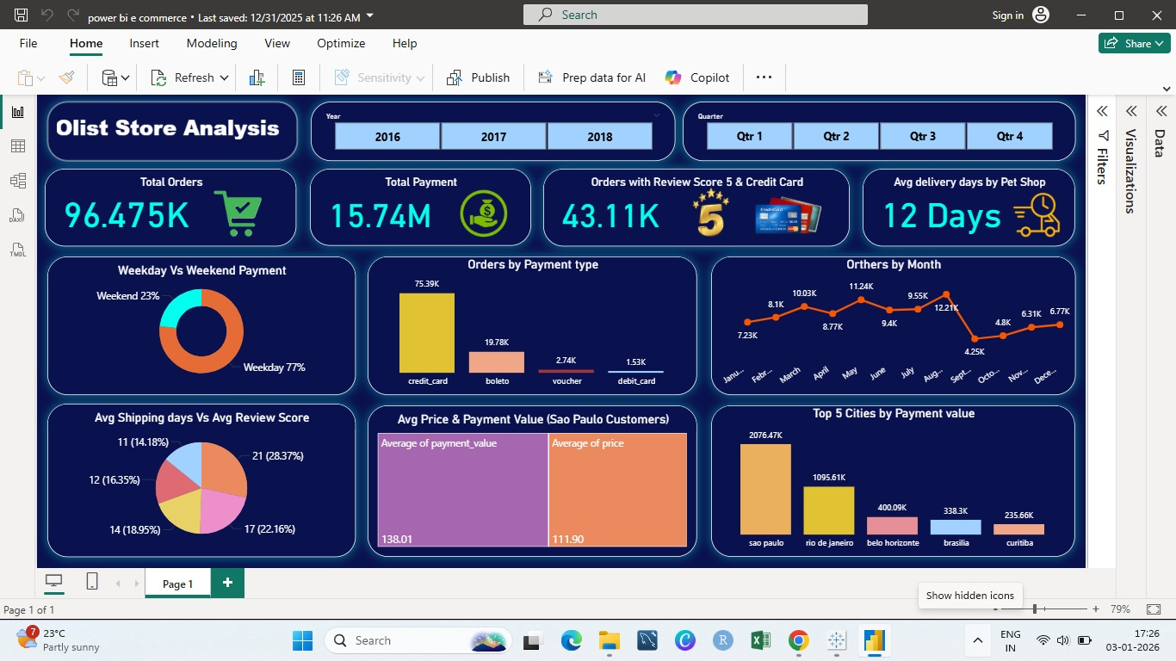
POWER BI DASHBOARD
SQL
Summary
Excel
Power BI
KPI List
Group
Questions
Tableau
Takeaway
ADVANCED ANALYSIS AND PERFORMANCE TRACKING
Revenue & Sales Insight: High order volumes and peak-season trends highlight key opportunities to optimize pricing, promotions, and product availability.
Customer Behavior Insight: One-time vs. repeat purchase patterns, along with top customer regions, reveal opportunities for loyalty programs and targeted engagement.
Product & Category Insight: Top-selling categories like electronics, fashion, and home appliances drive most revenue, while underperforming categories indicate areas for growth.
Operational & Delivery Insight: Payment preferences, order fulfillment, and delivery timelines help track efficiency, highlight potential delays, and optimize logistics strategies.

Slide 8
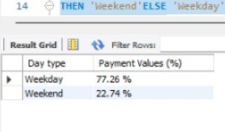
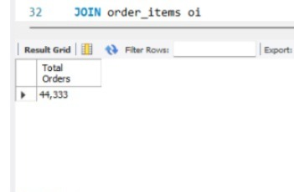
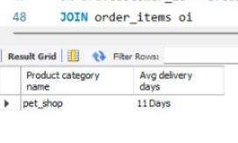
SQL
1) Weekday Vs Weekend (order_purchase_timestamp) Payment Statistics.
SELECT Kpi1.`Day type`,
CONCAT(ROUND(
Kpi1.total_payments / (SELECT SUM(payment_value) FROM order_payments) * 100,2),' %') AS `Payment Values (%)`
FROM (SELECT ord.`Day type`, SUM(pmt.payment_value) AS total_payments
FROM order_payments AS pmt
JOIN (SELECT DISTINCT order_id, CASE
WHEN WEEKDAY(order_purchase_timestamp) IN (5,6)
THEN 'Weekend'ELSE 'Weekday'
END AS `Day type`
FROM orders ) AS ord ON ord.order_id = pmt.order_id
GROUP BY ord.`Day type`) AS Kpi1;
2) Number of Orders with review score 5 and payment type as credit card.
SELECT FORMAT(COUNT(pmt.order_id), 0) AS `Total Orders`
FROM order_payments pmt
INNER JOIN reviews rev
ON pmt.order_id = rev.order_id
WHERE rev.review_score = 5
AND pmt.payment_type = 'Credit_Card';
Summary
KPI List
Group
Excel
Takeaway
SQL
Tableau
Questions
Power BI
3) Average number of days taken for order_delivered_customer_date for pet_shop.
SELECT p.product_category_name AS `Product category name`,
CONCAT(ROUND(AVG(DATEDIFF(ord.order_delivered_customer_date,ord.order_purchase_timestamp))),' Days') AS `Avg delivery days`
FROM orders ord
JOIN order_items oi
ON ord.order_id = oi.order_id
JOIN products p
ON oi.product_id = p.product_id
WHERE p.product_category_name = 'pet_shop'
AND ord.order_delivered_customer_date IS NOT NULL
GROUP BY p.product_category_name;

Slide 9
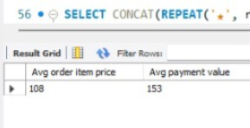
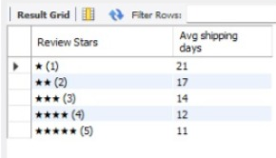
4) Average price and payment values from customers of sao paulo city.
SELECT
ROUND(AVG(oi.price)) AS `Avg order item price`,
ROUND(AVG(pmt.payment_value)) AS `Avg payment value`
FROM orders ord
JOIN customers c
ON ord.customer_id = c.customer_id
JOIN order_items oi
ON ord.order_id = oi.order_id
JOIN order_payments pmt
ON ord.order_id = pmt.order_id
WHERE c.customer_city = 'sao paulo';
5) Relationship between shipping days (order_delivered_customer_date - order_purchase_timestamp) Vs review scores.
SELECT CONCAT(REPEAT('★', r.review_score),' (',r.review_score,')') AS `Review Stars`,
ROUND(AVG(DATEDIFF(ord.order_delivered_customer_date, ord.order_purchase_timestamp)),0) AS `Avg shipping days`
FROM orders ord
JOIN reviews r
ON r.order_id = ord.order_id
WHERE ord.order_delivered_customer_date IS NOT NULL
GROUP BY r.review_score
ORDER BY r.review_score;
Summary
KPI List
Group
SQL
Excel
Takeaway
Tableau
Questions
Power BI
INSIGHT GENERATION
Sales Performance: Tracks total orders, revenue trends, and business growth.
Delivery Efficiency: Monitors on-time vs delayed deliveries to improve customer experience.
Top Products & Categories: Identifies best-selling items to support stock and marketing decisions.
Customer Retention: Analyzes new vs repeat customers to understand loyalty and engagement.
Order Status Monitoring: Reviews delivered, canceled, and pending orders to assess operational health.

Slide 10
KEYTAKE AWAYS
INSIGHTS
Boost Revenue: Optimize product sales and pricing.
Improve Operations: Streamline inventory and delivery.
Enhance Customer Experience: Faster service, happier buyers.
Data-Driven Decisions: Analyze trends and performance.
Market Insights: Track demand and top products.
Better Collaboration: Coordinate with suppliers and support.
Innovate Services: New products and personalized offers.
Excel
Group
Takeaway
Tableau
Summary
SQL
KPI List
Questions
Power BI
CHALLENGES
Inventory Management Issues: Stockouts or overstocking of products.
Logistics & Delivery Delays: Late shipments affecting customer satisfaction.
High Competition: Competing with multiple sellers and marketplaces.
Customer Retention: Maintaining loyalty and repeat purchases.
Data Accuracy & Insights: Incomplete or inconsistent sales and customer data.
Return & Refund Handling: Managing high return rates efficiently.

Slide 11
CONCLUSION
The Olist e-commerce store demonstrates significant potential for growth through data-driven strategies. By analyzing sales trends, customer behavior, and market demand, Olist can optimize product offerings, pricing, and marketing efforts to boost revenue. Operational efficiency, including inventory management and timely delivery, remains key to enhancing customer satisfaction and loyalty. Challenges such as high competition, return management, and data accuracy require continuous monitoring and process improvement. By focusing on innovation, personalized services, and effective collaboration with suppliers and logistics partners, Olist can strengthen its market presence and achieve sustainable success in the competitive e-commerce landscape.
Summary
Excel
SQL
KPI List
Group
Tableau
Conclusion
Power BI
Takeaway
THANK YOU

